Slide 1






My New School
Enter name of school
Insert image of new school

Slide 2


My name: ___________________________
I will be in K4/K5 next year!
Soon, I will explore my school with my family.
Insert the student’s photo.

Slide 3



K4/K5 Class
Here is a the K4/K5 classroom.
It is where I will learn and play
with my teachers and friends.
Insert photo of the classroom.

Slide 4
Here is the classroom bathroom.
Insert photo of the classroom bathroom.

Slide 5
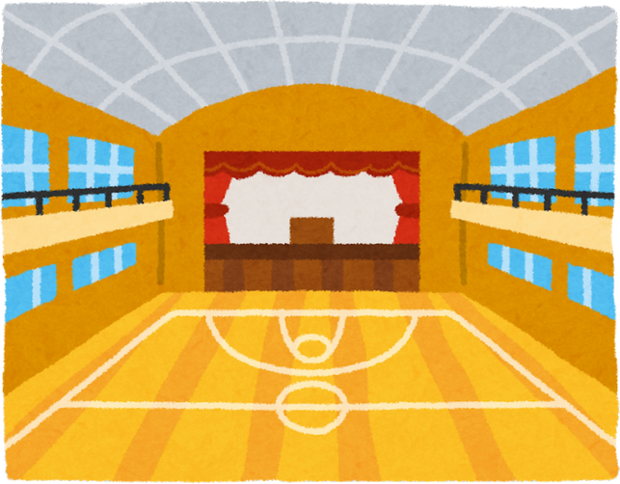

Gym
Here is the gym.
It is where I will run and play games
with my teacher and friends.
Insert photo of the gym.

Slide 6
School Bathrooms
Here are the school bathrooms.
There are many sinks for washing
our hands when we’re done.
Insert photo of the bathrooms.

Slide 7

Library
Here is the library.
It is where I will listen to stories
and borrow books to take home.
Insert photo of the library.

Slide 8

Daycare - SEED
Here is the space where I will sometimes
have special activities during SEED time.
Insert photo of the space..

Slide 9

Here is the hallway.
It is where I will walk quietly
to go from one place to the next in my school.
Insert photo of the hallway.

Slide 10



The Schoolyard
Here is the schoolyard.
It is where my friends and I will play outside every day.
Insert photo of the scoolyard..

Slide 11

K4/K5 Entrance
Here is the K4/K5 entrance.
It is where I will say goodbye to my parents and
hello to my teachers .
Insert photo of the entrance

Slide 12
Resource Room
Here is the resource room.
It is where students get to learn in small groups .
Insert photo of the resource room..

Slide 13

This is Ms./Mr.
S/he will greet me and my family with a smile.
Insert name.
Insert photo of the school secretary..
This is Ms./Mr.
S/he is our school principal.
Insert name.
Insert photo of the principal.

Slide 14



About me
I like:
Insert photo of the student..
I don’t like:
Name:
Something special about me:
Age:

