Slide 1








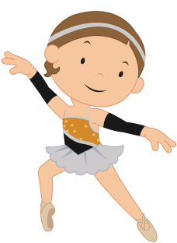


My Choices
special
computer
book
walk
toy
music
puzzle
draw
dance
Clipart by:

Slide 2
My Choices
Insert item here
Insert item here
Insert item here
Insert item here
Insert item here
Insert item here
Insert item here
Insert item here
Insert item here
Clipart by:

