Slide 1
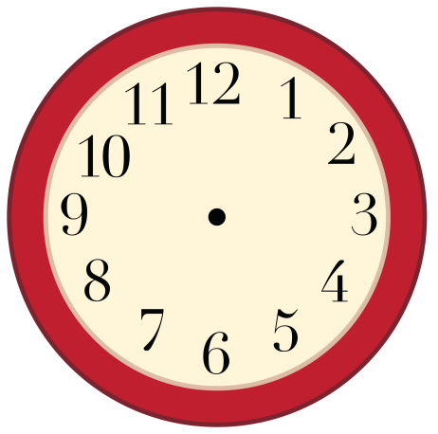
Calendar Time!
Clipart by:

Slide 2
What DAY of the week is it?
Sunday
Monday
The DAY of the week is:
Tuesday
Wednesday
Thursday
Friday
Saturday

Slide 3
What MONTH of the year is it?
The MONTH of the year is:
January
June
November
February
July
December
March
August
April
September
May
October

Slide 4
What YEAR is it?
2017
2019
The YEAR is:
2022
2021
2023
2020
2018

Slide 5
What day of the month is it?
Sunday | Monday | Tuesday | Wednesday | Thursday | Friday | Saturday

Slide 6
What day of the month is it?
1
2
3
4
5
6
7
8
9
10
11
12
13
14
15
16
17
18
19
20
21
22
23
24
25
26
27
28
29
30
31

Slide 7
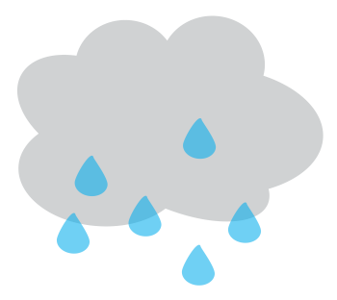
What is the weather?
The weather today is:
Snowy
Windy
Sunny
Cloudy
Stormy
Foggy
Rainy
Clipart by:

Slide 8
Today is:
The weather is:

